Slide 1
IoT Security and Privacy
Attacks against IoT

Slide 2
Learning Outcomes
Upon completion of this unit:
Students will understand attacks against IoT system (hardware + software)
Students will understand attacks against IoT network protocols
Students will understand attacks against industry IoT

Slide 3
Prerequisites and Module Time
Prerequisites
Students should have taken classes on operating system and computer architecture.
Students should know basic concepts of networking.
Module time
Two-hour lecture
One-hour homework

Slide 4
Outline
Introduction
Attacks against IoT system (hardware + software)
Attacks against IoT network protocols
Attacks against Industry IoT (IIoT)

Slide 5
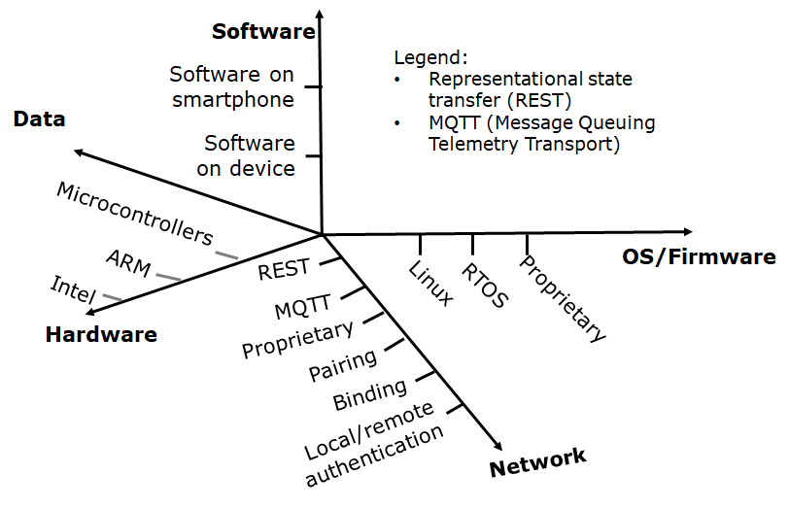
Introduction
Attacks can be directed against hardware, OS/Firmware, network, software and data
Any design flaws leave vulnerabilities
We will show examples of attacks later
Learning to think like an attacker to better design defense
Because of attacks, defense is needed, right?

Slide 6
Outline
Introduction
Attacks against IoT system (hardware + software)
Attacks against IoT network protocols
Attacks against Industry IoT (IIoT)

Slide 7
IoT Hardware Security
Hardware security is critical when attackers can physically access the IoT devices.
Many IoT devices do not disable their debugging ports after the testing and validation stage, which give attackers full access to the internal firmware.
Most IoT devices have hardware vulnerabilities which may be exploited by attackers including
the UART/JTAG debugging ports,
multiple boot options, and
unencrypted flash memory.
Through the hardware backdoors, attackers can easily bypass software level integrity checking by either disabling the checking functionality or booting the system through an injected firmware image.

Slide 8
Universal asynchronous receiver-transmitter (UART)
A UART controller is a microchip and a key component of serial communication of a SoC (System on a Chip).
At the transmitter side, a UART takes bytes of data and sends them out bit by bit sequentially.
At the receiver side, a UART reassemble the bits into bytes.
A debugger can hook a UART cable to the SoC and log into the operating system for debugging.
A UART port is often left on the device board for the sake of technical support in order to figure out what may go wrong when a device has problems.

Slide 9
SPI (Serial Peripheral Interface Bus)
Flash memory is often connected via SPI to the CPU on a SoC.
We can desolder the flash and remove it from the IoT device board.
Then we can dump the content through a chip programmer or a bus pirate to dump the flash memory to a computer.
We may dump the flash when it is in circuit on the board.
In this case, care has to be taken not to interfere with the running board and cause the failure of dumping.

Slide 10
Joint test action group (JTAG)
JTAG serves two major roles: boundary scan and debug access.
With boundary scan, one can ensure components of a device are correctly connected.
With debug access, one can interact the SoC and access registers, memories and even pause and redirect the instruction flow.
including the firmware.

Slide 11
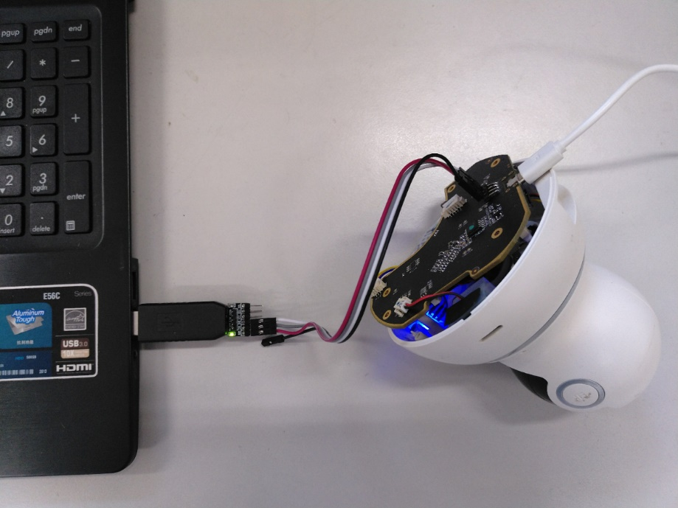
Example Hack – an IP camera
Locate the UART interface on the IoT device board such as a smart camera
Use a USB to UART bridge to connect the IoT device to the computer
Set up the terminal software (such as Putty) to communicate with the IoT device
Power on the IoT device
If lucky, no password!
IoT device
USB to UART bridge

Slide 12
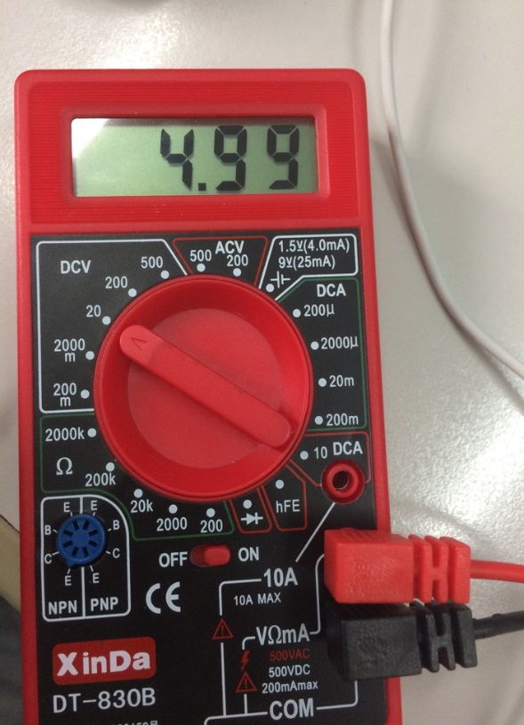
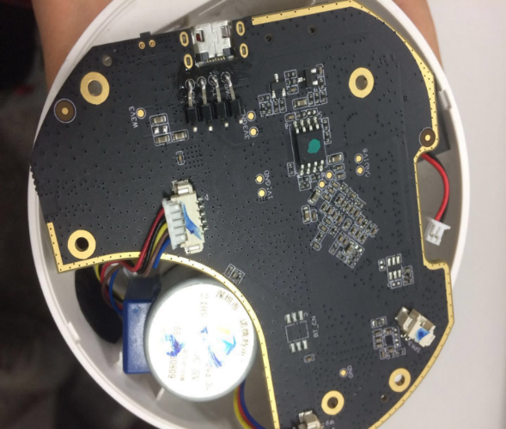
1. Locate the UART interface
Carefully disassembly the IoT device
Use a voltmeter to identify VCC,TX,RX,GND of the UART interface
GND – 0v
VCC – 3.3v or 5v
TX – peak 3.3V but vibrating
RX – often close to TX pin

Slide 13
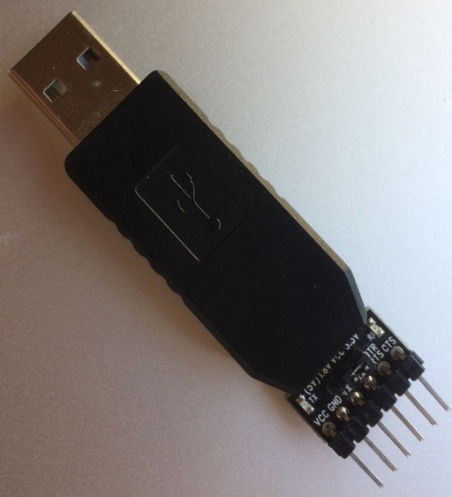
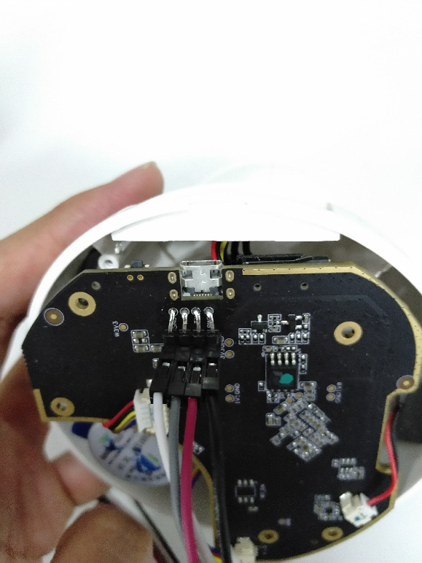
2. USB to UART bridge from device to computer
Install the driver of the bridge

Slide 14
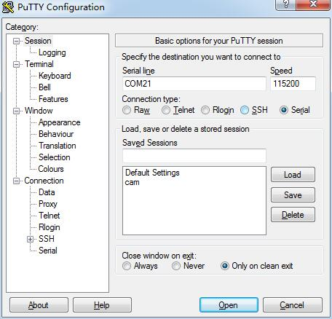
3. Set up the terminal software
Use the device management software to identify the communication port of the USB to USRT bridge (Com or LPT)
For example, USB SERIAL CH340 (COM21)
Configure Putty

Slide 15
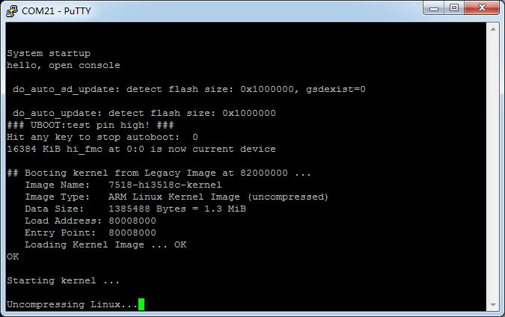
4. Power-on the IoT device
Example: a camera

Slide 16
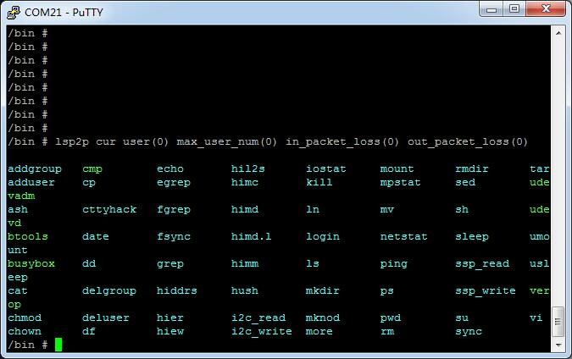
Example (Cont’d)

Slide 17
Then what?
Now we can analyze the system software and see if there are vulnerabilities
We can also use the MITM to analyze the communication protocols at the side of the IoT device and identify vulnerabilities
Mitmproxy
May need to change CA certificate in the device

Slide 18
Outline
Introduction
Attacks against IoT system
Attacks against IoT network protocols
Attacks against Industry IoT (IIoT)

Slide 19
Issues
Weak authentication protocols
Un-sanitized user input
Various programming bugs

Slide 20
Edimax Smart Plug
Authentication server
Command relay server

Slide 21
Insecure Communication Protocols
No cryptographic mechanisms for the communication protocols
No encryption
Obfuscation based on a bit shifting strategy
Reverse engineering attack
Communication protocol details
Traffic analysis attacks
Password, user name if the traffic can be monitored

Slide 22
Device Scanning Attack
Password based user authentication
User name: MAC address
Password: default “1234”
Scanning the vendor’s MAC address space
Find the online status of all smart plugs
Reveal the use of default password
Many users do not change default passwords!!!
Brute force attack against non-default passwords
No intrusion detection

Slide 23
Device Spoofing Attack
A fake plug (program) registers itself with the cloud
The real device is pushed offline temporarily
Credentials leak once users open the app
Software bot as fake plug

Slide 24
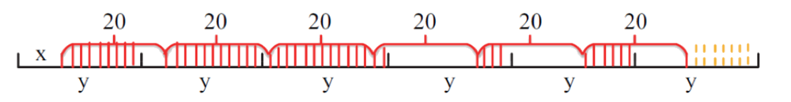
Success Rate of Device Spoofing Attack
Keep-alive messages from real plug every 20 minutes
Keep-alive messages from fake plug every y minutes
Success rate $S=1−\int_{x=0}^{20}{\frac{\sum_{i=0}^{n−1}{T\left(i\right)+T(n)}}{20\left\lceil (x+20n)/y\right\rceil y}ⅆx}\text{, }\text{n}\text{>1}$
x: the time between first attack packet and real plug’s first keep-alive message after the attack starts
T(i): the period in which real plug is active in i^{th} 20 minutes
Attack starts
Notes:
If the spoofed plug were online as long as possible, the
success rate of obtaining the victim’s credential would increase
significantly. Denote x as the time between the first “1010”
packet from the attacker and the first “1010” packet of the
genuine plug sent during the attack process, where x < 20 .
Denote y as the time interval between two consecutive “1010”
datagram packets sent by the attacker. During the spoofing
attack, assume that the total number of “1010” datagram
packets emitted by the genuine plug is n . Then the total time
of this attack is d(x + 20 n) =ye y . As shown in Figure 6,
the shaded parts marked with solid lines and dash lines are
controlled by the genuine plug, while the blank parts are controlled
by the spoofed plug. The time duration corresponding
to the shaded parts can be computed by

Slide 25
Evaluation of Device Spoofing Attack
Success rate vs fake registration packet time interval (y)

Slide 26
Local Firmware Attack
Open port for firmware update in local networks
No integrity checking and authentication for firmware upgrading/downgrading
Installation of any malicious firmware
Reverse tunnel back to the attacker
Reverse root shell can be opened
Full control of the plug OS

Slide 27
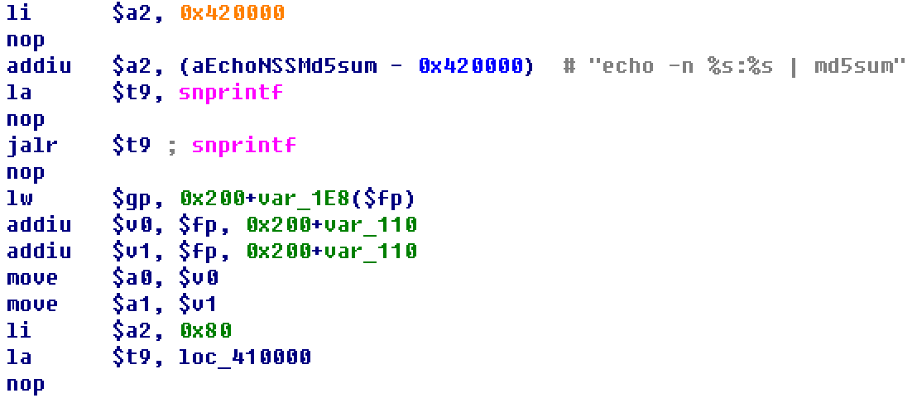
Remote Command Injection Attack
Vulnerability in password update
Calls a local md5 hash command to directly work on the user provided password with no sanitization
/bin/agent

Slide 28
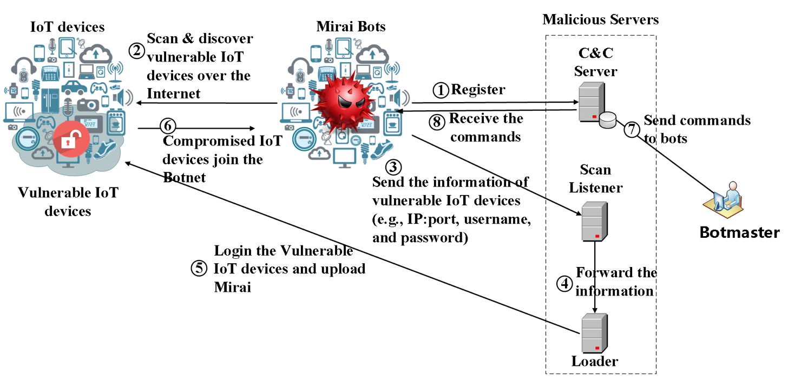
Mirai Botnet over IoT
Device spoofing attack + remote command inject attack
A new wave of Mirai DDoS!!!

Slide 29
Outline
Introduction
Attacks against IoT system
Attacks against IoT network protocols
Attacks against Industry IoT (IIoT)

Slide 30
Issues
If any device is connected to the Internet, they are in danger.
Same thing goes to any industry machinery

Slide 31

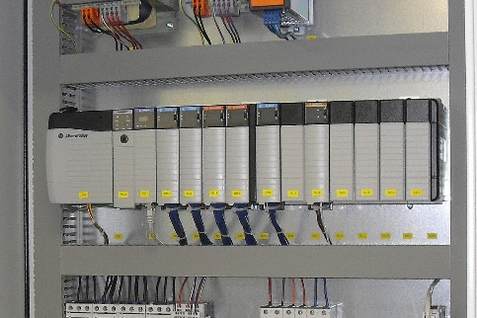
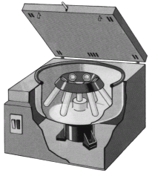
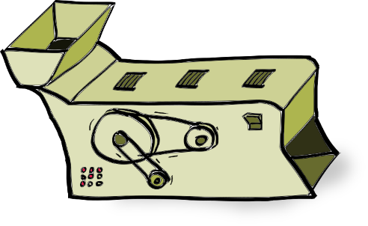
Industry IoT (IIoT)
Supervisory control and data acquisition (SCADA)
programmable logic controller (PLC)

Slide 32
Stuxnet
Stuxnet was computer worm
It targets SCADA systems and caused serious damage to Iran's nuclear program.
It utilized four zero-day flaws, targeted Microsoft Windows operating system and networks
Locating Siemens Step7 software, “The programming software for the controller families S7-300, S7-400, C7 and WinAC”
Propagation
introduced to the target networked system via an infected USB flash drive
Propagates across the network, searching for Siemens Step7 software - industrial control systems - on computers
Infects PLC and Step7 software with rootkits

Slide 33
References
[1] Zhen Ling, Junzhou Luo, Yiling Xu, Chao Gao, Kui Wu, Xinwen Fu, "Security Vulnerabilities of Internet of Things: A Case Study of the Smart Plug System", accepted to appear in IEEE Internet of Things Journal (IoT-J), 2017.
[2] Kaizheng Liu, Ming Yang, Zhen Ling, Huaiyu Yan, Yue Zhang, Xinwen Fu, and Wei Zhao, On Manually Reverse Engineering Communication Protocols of Linux Based IoT Systems, IEEE Internet of Things Journal ( IoT-J), Volume: 8, Issue: 8, April15, 15 2021. DOI: 10.1109/JIOT.2020.3036232.
[3] Stuxnet, 2018

